Slide 1
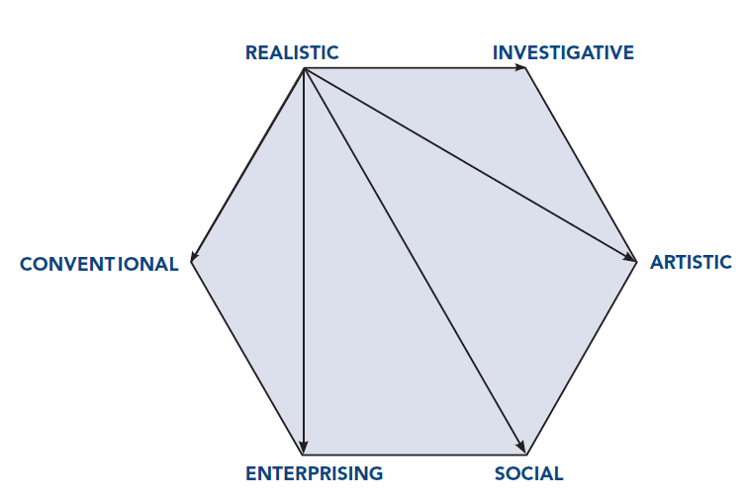
Impact of RIASEC Personality Types and Negative Thinking: Implications for Career Counseling
Jennifer A. Greene, MSPH & Melissa A. Messer, MHS
Psychological Assessment Resources, Inc. Lutz, FL
ABSTRACT
METHOD (con’t.)
John Holland’s RIASEC theory of workplace personality posits that most people and occupations resemble a combination of six personality types (Realistic, Investigative, Artistic, Social, Enterprising, and Conventional). The Self-Directed Search (SDS), 5th Edition, an assessment of the RIASEC types, is the focus of this study. This poster explores the relationship between the SDS and negative career thoughts as measured by the Career Thoughts Inventory. It is hypothesized that Social and Enterprising types will be less likely to endorse negative career thinking, while Realistic and Conventional types will be more likely. Moreover, it is theorized that low scores on secondary constructs of the SDS (congruence, consistency, coherence, differentiation, and profile elevation) will be related to higher endorsement of negative career thoughts. By examining SDS scores within groups of individuals with elevated versus non-elevated levels of negative career thoughts, both hypotheses were supported. Based on the findings of this study, Realistic and Conventional types may be more prone to negative career thoughts and may need additional career or personal counseling during the career development process. Moreover, the secondary constructs of the SDS are related to negative career thinking, which can impede career development. Practical implications for college career counseling are demonstrated via an illustrative case study.
SDS Construct | Definition | Calculation
Congruence | Degree of fit between a Summary Code and code of current job aspirations | Iachan Agreement Index (Iachan, 1984a), ranges from 0 to 28, with higher scores indicating more agreement between the two codes.
Consistency | Similarity of position of first two code letters on the hexagon | High: first two letters of the code are adjacent on the RIASEC hexagon , such as R and C, assigned a score of 3 Average: first two letters are alternate (i.e., neither adjacent nor opposite), such as I and S, assigned a score of 2 Low: first two letters are opposite, such as C and A, assigned a score of 1
Coherence | Degree of similarity between the first letters of the individual’s first three listed occupational aspirations | High: first three occupational aspirations have the same first letter, assigned a score of 3 Average: first letter of the first aspiration is also the first letter in the second or third aspiration, assigned a score of 2 Low: first letter of the first aspiration is not the first letter of the second or third aspiration, assigned a score of 1
Differentiation | Shape of the profile of summary scores, i.e., flat or spiked | Iachan Differentiation Index (Iachan, 1984b), ranges from 0 to 20, with higher scores indicating more differentiation.
Profile Elevation | overall level of endorsement of items across all domains of the SDS | Summing the total number of items endorsed across all RIASEC scales, ranges from 12 to 336, with higher scores indicating higher endorsement across all RIASEC domains.
INTRODUCTION
Instruments
Career Thoughts Inventory (CTI)
The CTI (Sampson, Peterson, Lenz, Reardon & Saunders, 1996) is a self-administered measure of dysfunctional thinking in career problem solving and decision making.
It consists of four scales: Decision Making Confusion (DMC), Commitment Anxiety (CA), External Conflict (EC), CTI Total.
Higher scores indicate higher levels of the scale’s measured construct.
Self-Directed Search (SDS), 5th Edition.
The SDS (Holland & Messer, 2013) is a self-administered career counseling tool. It is divided into four sections: activities, competencies, occupations, and self-estimates.
The top three scores across all sections represent an individual’s Summary Code, the three personality types they most resemble.
Several secondary scores can also be computed from the SDS: congruence, consistency, coherence, differentiation, and profile elevation
Participants were divided into two groups based on their CTI total T-score.
T-score of 60 or above: elevated negative career thinking
T-score of less than 60: non-elevated negative career thinking
Independent samples t-tests were conducted using these two groups on mean endorsement of each RIASEC type and mean congruence, consistency, coherence, differentiation and profile elevation.
The effect size, Cohen’s d, was calculated to measure of the size of the each difference between groups. An effect size of .20 is considered small, .50 is considered medium and .80 or higher is considered large.
John Holland’s RIASEC theory of workplace personality has featured prominently in the field of career counseling over the past 60 years.
This theory posits that most people and occupations resemble a combination of six personality types (Realistic, Investigative, Artistic, Social, Enterprising, Conventional).
From his theory, Holland developed the Self-Directed Search (SDS; Holland & Messer, 2013), a self-administered career counseling tool.
The SDS provides the user with a Summary Code, i.e., the three personality types to which they are most similar, as well as several secondary scores: congruence, consistency, coherence, differentiation, and profile elevation.
Previous studies (Chason, Bullock-Yowell, Sampson, Lenz, Reardon, 2013; Wright, Reardon, Peterson, & Osborn, 2000) have focused on the relationship between secondary constructs of the Self-Directed Search and negative career thoughts as measured by the Career Thoughts Inventory (Sampson, Peterson, Lenz, Reardon & Saunders, 1996).
In order to further elucidate the relationship between SDS constructs and negative career thoughts, the current study aims to examine the secondary constructs with the newest edition of the SDS.
METHOD
Hypothesis 1: Low scores on the SDS secondary constructs (congruence, consistency, coherence, differentiation, and profile elevation) are related to higher endorsement of negative career thoughts.
Hypothesis 2: Social and Enterprising types are less likely to endorse negative career thinking, and R and C types are more likely to do so.
Participants
A total of 1,739 individuals were recruited nationwide to complete SDS, 5th edition and a subset of this sample (n = 51) also completed the Career Thoughts Inventory (Sampson, Peterson, Lenz, Reardon & Saunders, 1996).
Of the sample, 51% (N=26) were enrolled in college or completed college at the time of the study.
RESULTS
Table 1
Demographic Characteristics of the Sample
Characteristic | N (%) or M (SD)
 | Overall | Elevated Group | Non-Elevated Group
n | 51 | 22 | 29
Gender
Male | 26 (51.0) | 11 (50) | 15 (51.7)
Female | 25 (49.0) | 11 (50) | 14 (48.3)
Age (years)
M | 34.24 | 36.82 | 32.28
SD | 17.04 | 19.87 | 14.60
Range | 11-69 | 15-69 | 11-69
Race/ethnicity
Caucasian | 22 (43.1) | 10 (45.5) | 12 (41.4)
African American | 8 (15.7) | 2 (9.1) | 6 (20.7)
Hispanic | 19 (37.3) | 9 (40.9) | 10 (34.5)
Other | 2 (3.9) | 1 (4.5) | 1 (3.4)
Table 2
Means and Effect Sizes for Elevated and Non-Elevated Participants on the SDS Code Types and Secondary Constructs
 | Elevated (n=22) |  | Non-Elevated (n=29) |  | Mean difference | Effect size
SDS Code Type | M | SD | M | SD
Realistic | 18.32 | 14.96 | 16.83 | 12.40 | 1.49 | .11
Investigative | 16.64 | 10.76 | 18.48 | 11.54 | -1.84 | .17
Artistic | 17.55 | 13.61 | 16.17 | 11.18 | 1.38 | .11
Social | 23.14 | 12.13 | 23.93 | 12.89 | -0.79 | .06
Enterprising | 21.73 | 8.37 | 23.66 | 11.25 | -1.93 | .19
Conventional | 24.09 | 7.90 | 18.10 | 11.69 | 5.99 | .60*
Secondary Construct
Congruence | 14.41 | 8.13 | 18.48 | 8.42 | -4.07 | .50
Consistency | 2.18 | .73 | 2.34 | .67 | -0.16 | .24
Coherence | 1.65 | .70 | 2.05 | .74 | -0.40 | .57
Differentiation | 6.28 | 3.57 | 5.84 | 3.38 | 0.45 | .13
Profile Elevation | 131.86 | 33.21 | 149.34 | 45.49 | -17.48 | .44
DISCUSSION/CASE STUDY
Realistic and Conventional types, as well as those with low scores on the secondary constructs of the SDS, may be more prone to negative career thoughts and may need additional career or personal counseling during the career development process.
The case study below provides an example of the applications of this principle.
Bruce is a college sophomore trying to decide on a major. After making an appointment with a career counselor at his university’s career center, he takes the SDS. His Summary Code is RSA (Realistic, Social, Artistic). Based on his SDS results, Bruce’s career counselor notes that he has low differentiation (i.e., a flat profile) and his code as low consistency. Given this information and the fact that Bruce is a Realistic type, he may be prone to negative career thinking. His career counselor decides to have Bruce take the CTI as well, to assess his readiness to decide on a major. Bruce’s scores on the CTI are indeed elevated and indicate that he is having a lot of anxiety about committing to a major. During their next meeting, Bruce confirms this finding and tells his career counselor he is experiencing anxiety across several life domains. Bruce’s career counselor suggests that he do some personal counseling to help alleviate his anxiety, in addition to working with his career counselor to pick a major.
Sample Characteristics: Both the elevated and non-elevated groups were similar in terms of gender, age and racial/ethnic breakdown (see Table 1).
Hypothesis 1: Supported.
The elevated group had lower means on all secondary constructs except for differentiation.
These differences were particularly noticeable on congruence, coherence and profile elevation, with medium effect sizes (d=.50, .57, .44, respectively).
None of the t-tests found a significant difference, but the trend of the differences were in the right direction with small and medium effect sizes.
Hypothesis 2: Supported.
The elevated group had higher means of endorsement of the Realistic and Conventional types than the non-elevated group.
The elevated group had lower means of endorsement of the Social and Enterprising types than the non-elevated group.

